Slide 1



MINISTRY OF HEALTH
NATIONAL SURVEILLANCE LABORATORY
NATIONAL HIV LABORATORY
Certification Program
RITA ISABEL MEZA MSc.
HEAD NATIONAL HIV LABORATORY -HONDURAS
August 2024

Slide 2



Introduction
Rapid diagnostic tests for HIV have played a very important role in the response to this epidemic since the 1990s, and their increased use at any level of the health system increases the availability, scope and coverage of diagnosis.
The certification of services ensures that tests are performed in compliance with established quality indicators to provide a reliable, accurate and timely result, for which evaluators must be certified.

Slide 3

Objectives
Train and certify all personnel performing HIV rapid tests and Monitor quality progress
Updating and evaluating the performance of personnel performing rapid tests for HIV diagnosis
Increase site certification by reviewing previous improvement plans identified in the baseline audit
Increase sites that perform rapid HIV testing and their participation in the proficiency panel program

Slide 4

Staff profile
Requirement
To have a degree in Microbiology with orientation in clinical analysis.
Addressed to
Microbiologist laboratory supervisors
Regional Microbiologist

Slide 5

Duration and modality
This interactive training program will be developed on a face-to-face basis with a duration of 45 hours divided into 5 days (8:00-5:00 pm).
It consists of classroom presentations, hands-on activities, including laboratory sessions, computer data management and evaluation of health facilities.
Only participants who have passed at least 80% of the theoretical and practical training will be certified as trainers and will be issued a certification diploma.
Number of participants: minimum of 8 participants with a maximum of 15.

Slide 6

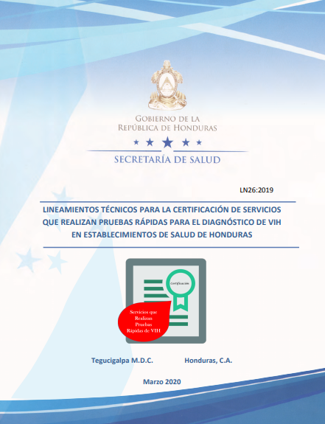

National guidelines
With the support of partners in the response to HIV, technical guidelines were developed for the certification of services that perform rapid tests in health facilities, NGOs, which propose a series of activities that seek a comprehensive approach to ensure the quality of the results, and which have been validated and implemented by the Ministry of Health of Honduras.

Slide 7
Modules for certifying evaluators
Introduction to the quality assurance cycle
Description of rapid HIV testing
Safety at HIV testing sites
Sample collection, handling and storage
1
2
3
4
Rapid HIV testing algorithm
HIV testing registry
Introduction to proficiency testing with MST
Professional ethics
5
6
7
8
Introduction to certification guidelines
Site evaluation
9
10

Slide 8
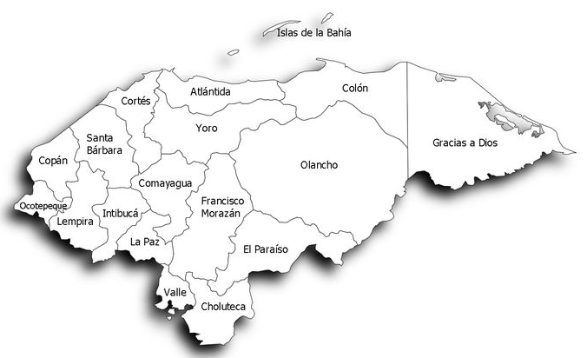



Microbiologists certified as evaluators
19 Microbiologists certified as evaluators
1 Microbiologist pending certification

Slide 9

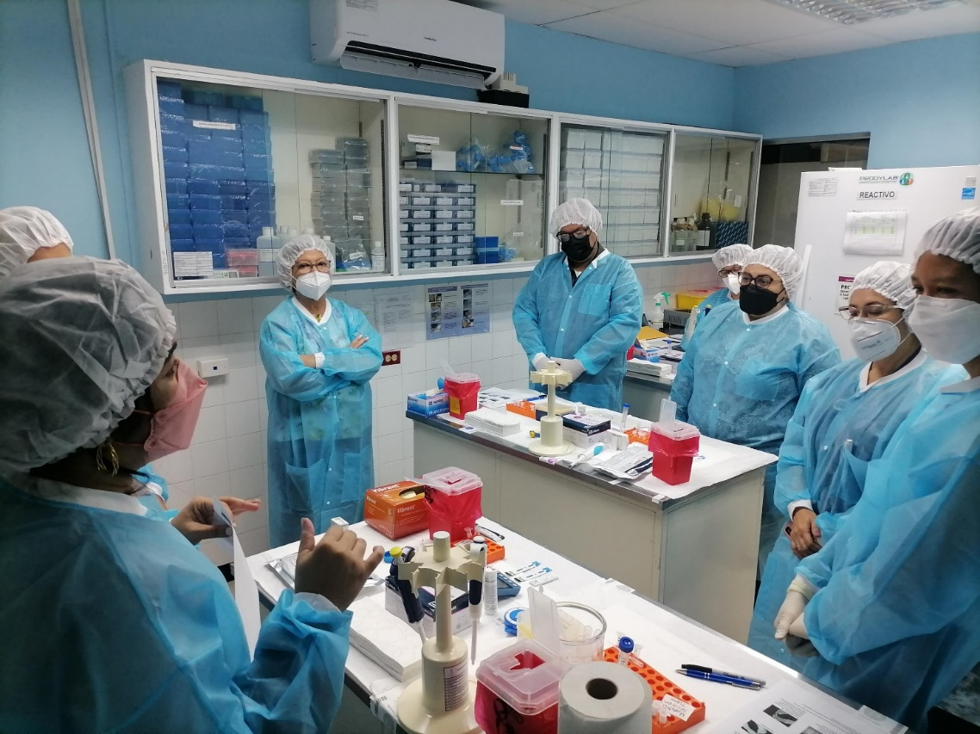



What do we continue to do?
Workshops to strengthen ToT for personnel in the regions
Laboratory network performance evaluations
IN SITU supervisions in different regions of the country
Certification of personnel who perform rapid tests for HIV diagnosis

Slide 10


Thank you!

